Slide 1

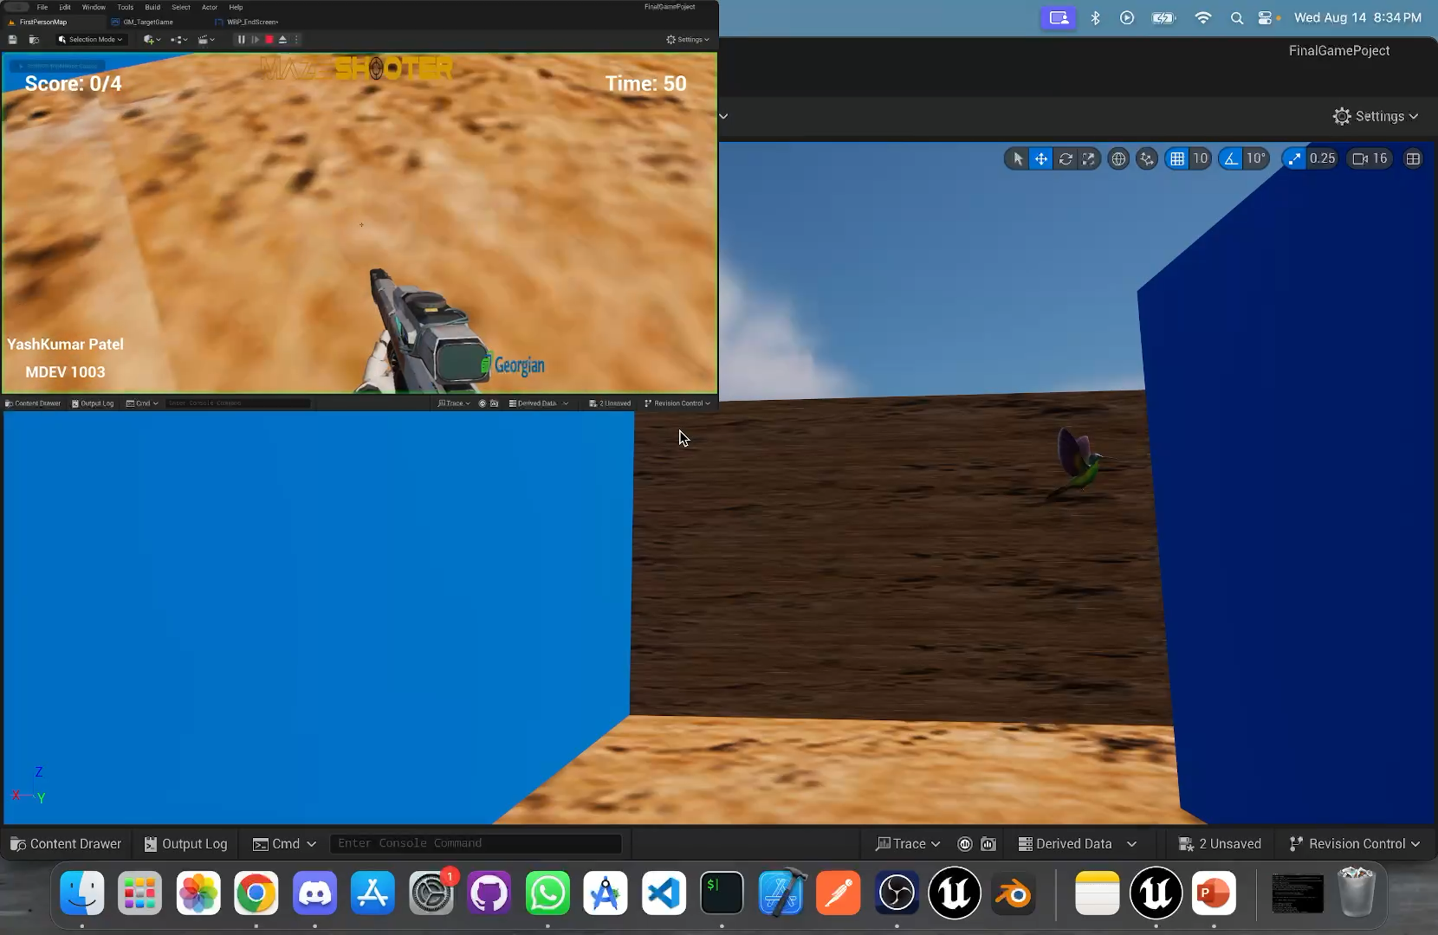
Maze shooter
YASHKUMAR PATEL
MDEV 1003
#200583719

Slide 2
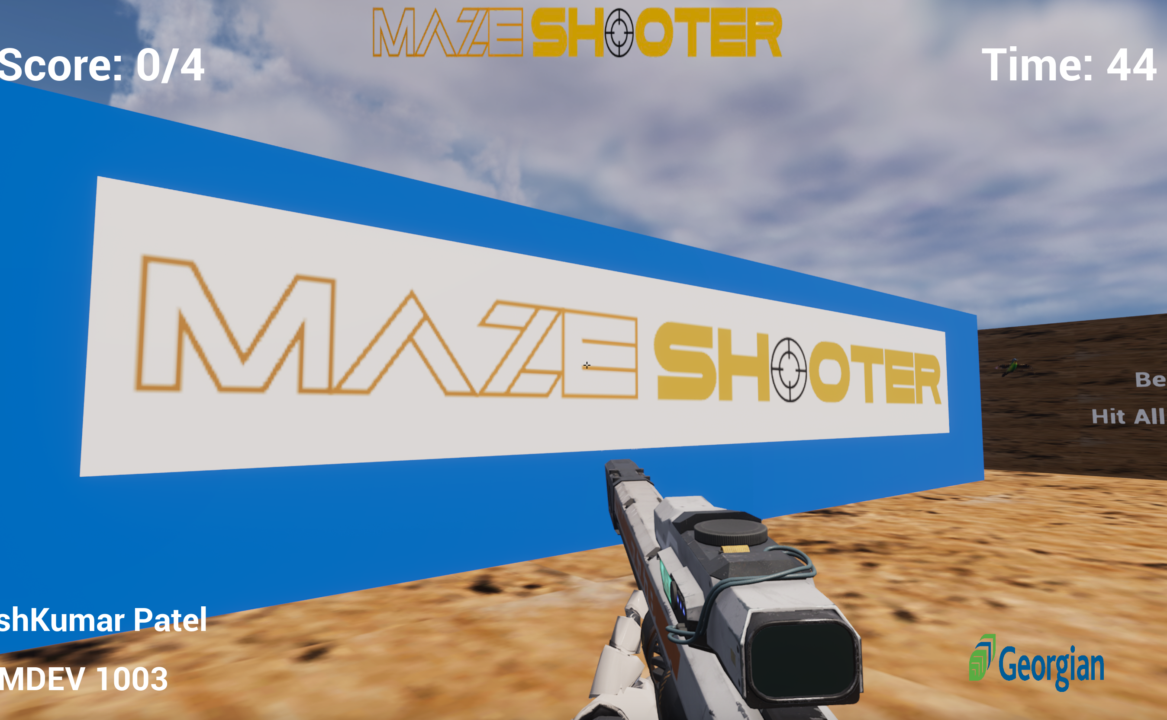
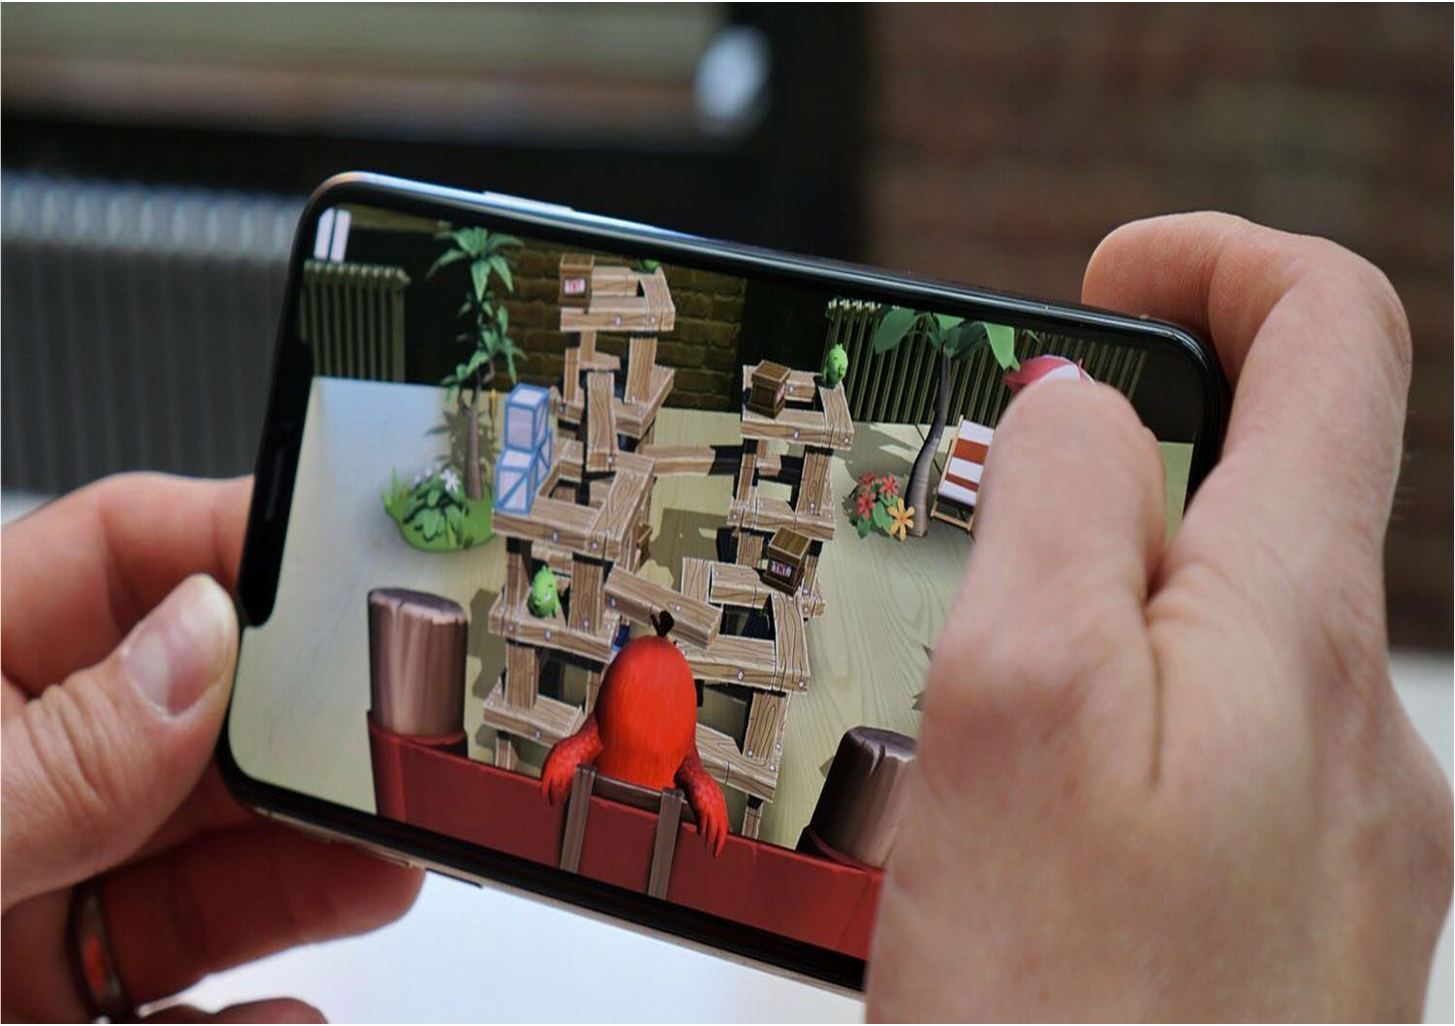
OVERVIEW
Maze Solving Strategies
Shooting Strategy
Time Management
Object Finding

Slide 3
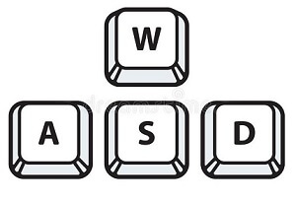

CONTROLS
WASD Keys are used for movement
Left mouse click is used for shooting
Drag mouse to navigate to different direction

Slide 4
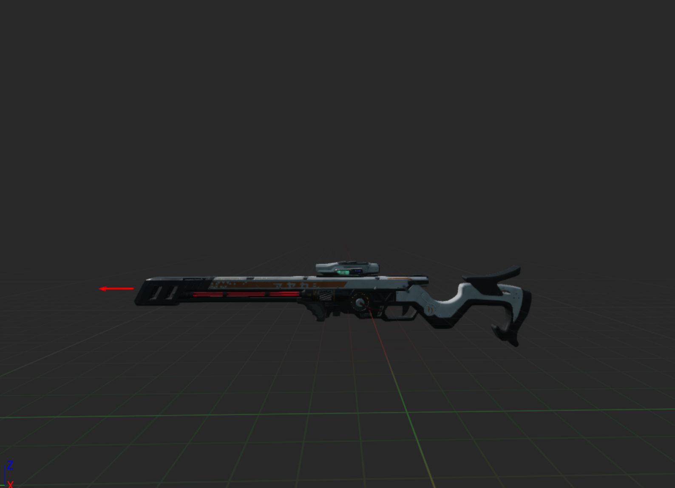
CHARACTERS
First Person Character
Initially holding a sniper rifle

Slide 5
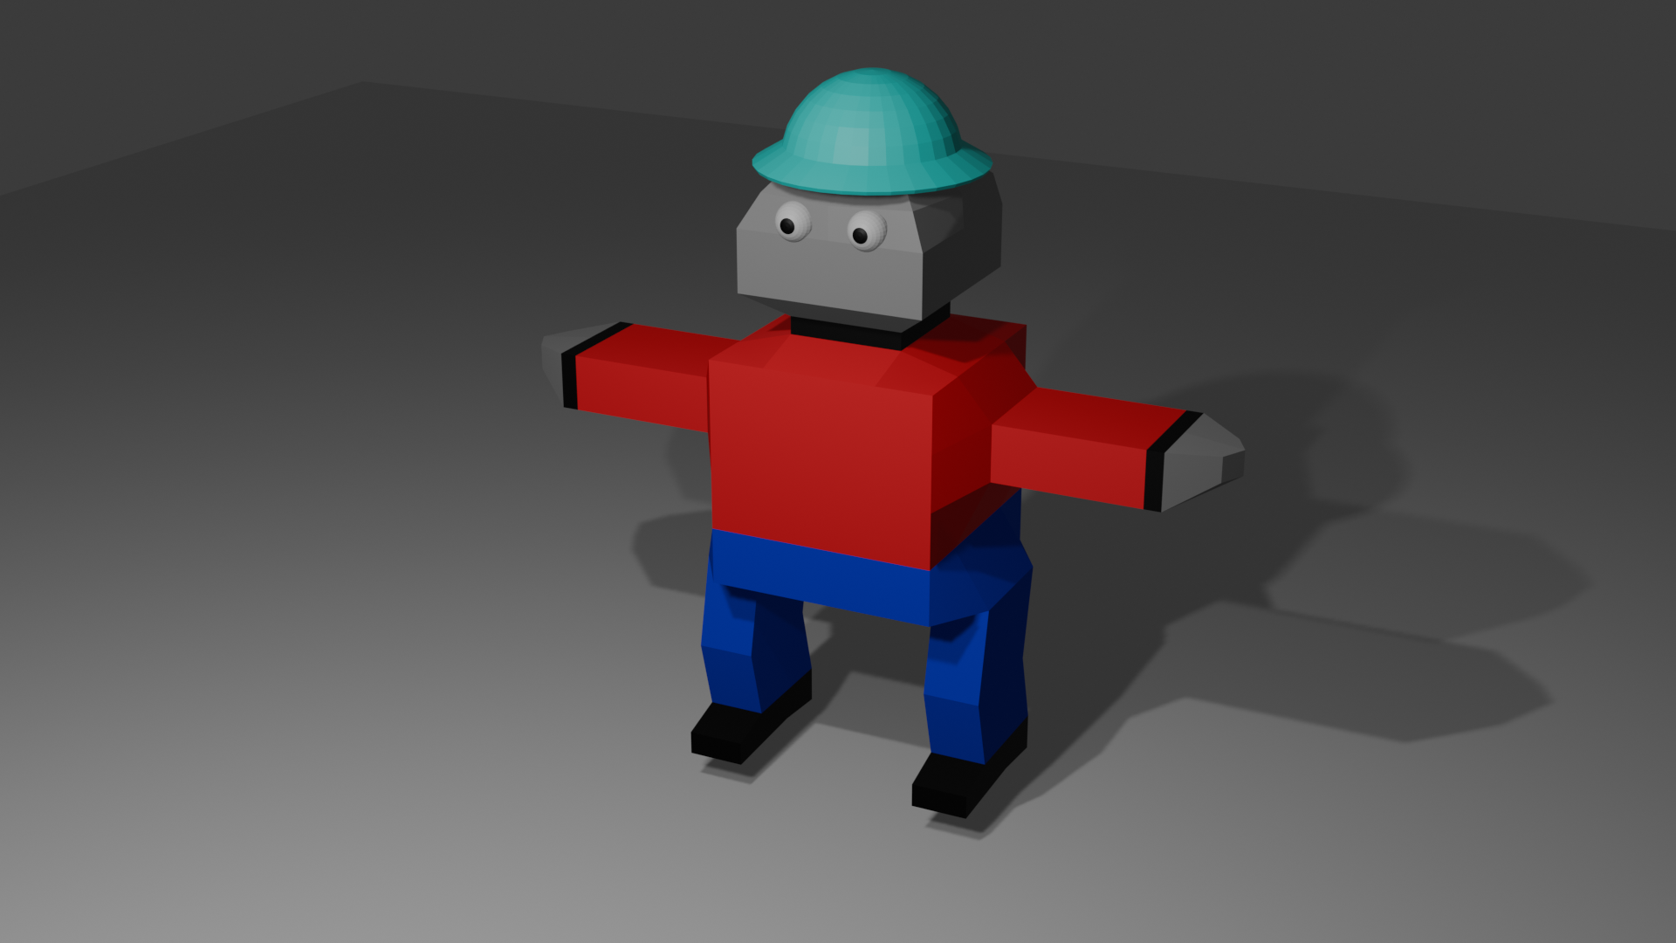
MODEL USED IN-GAME

Slide 6
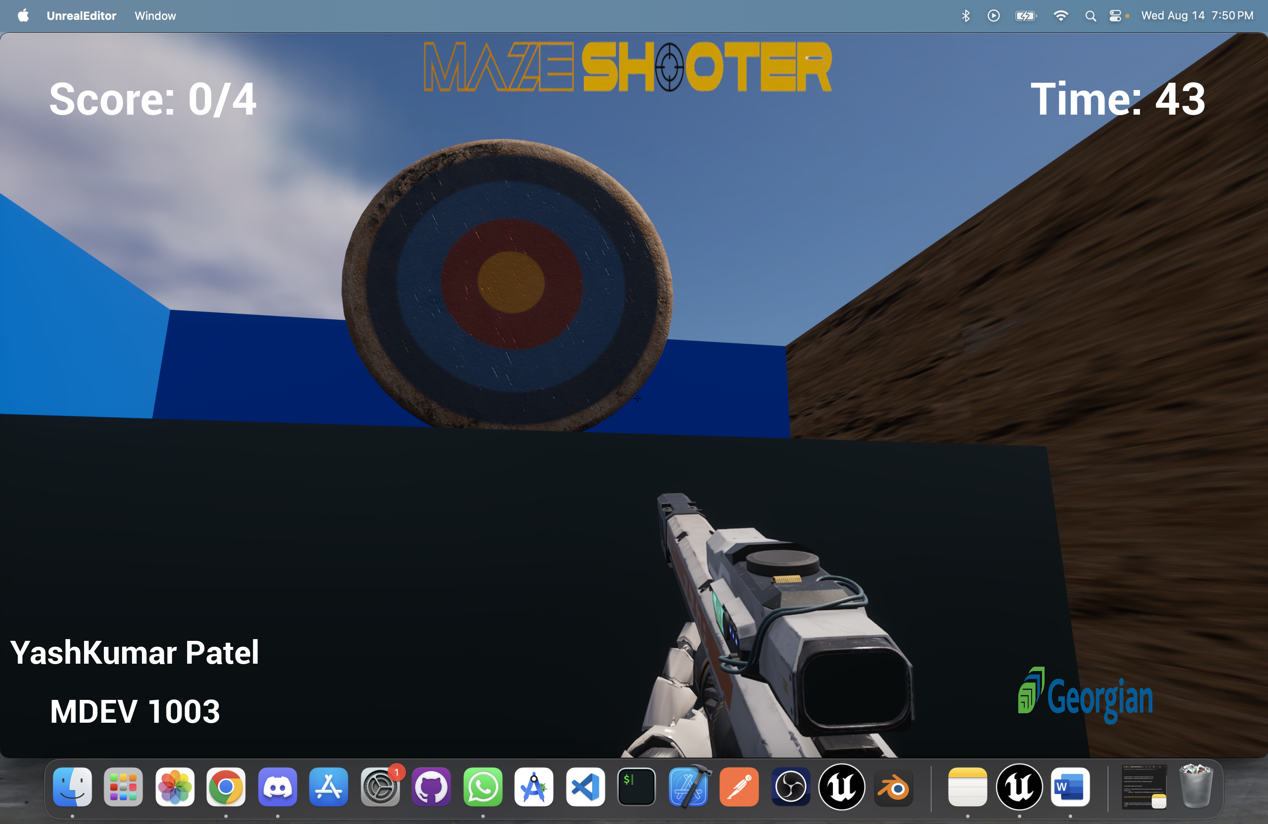

Slide 7
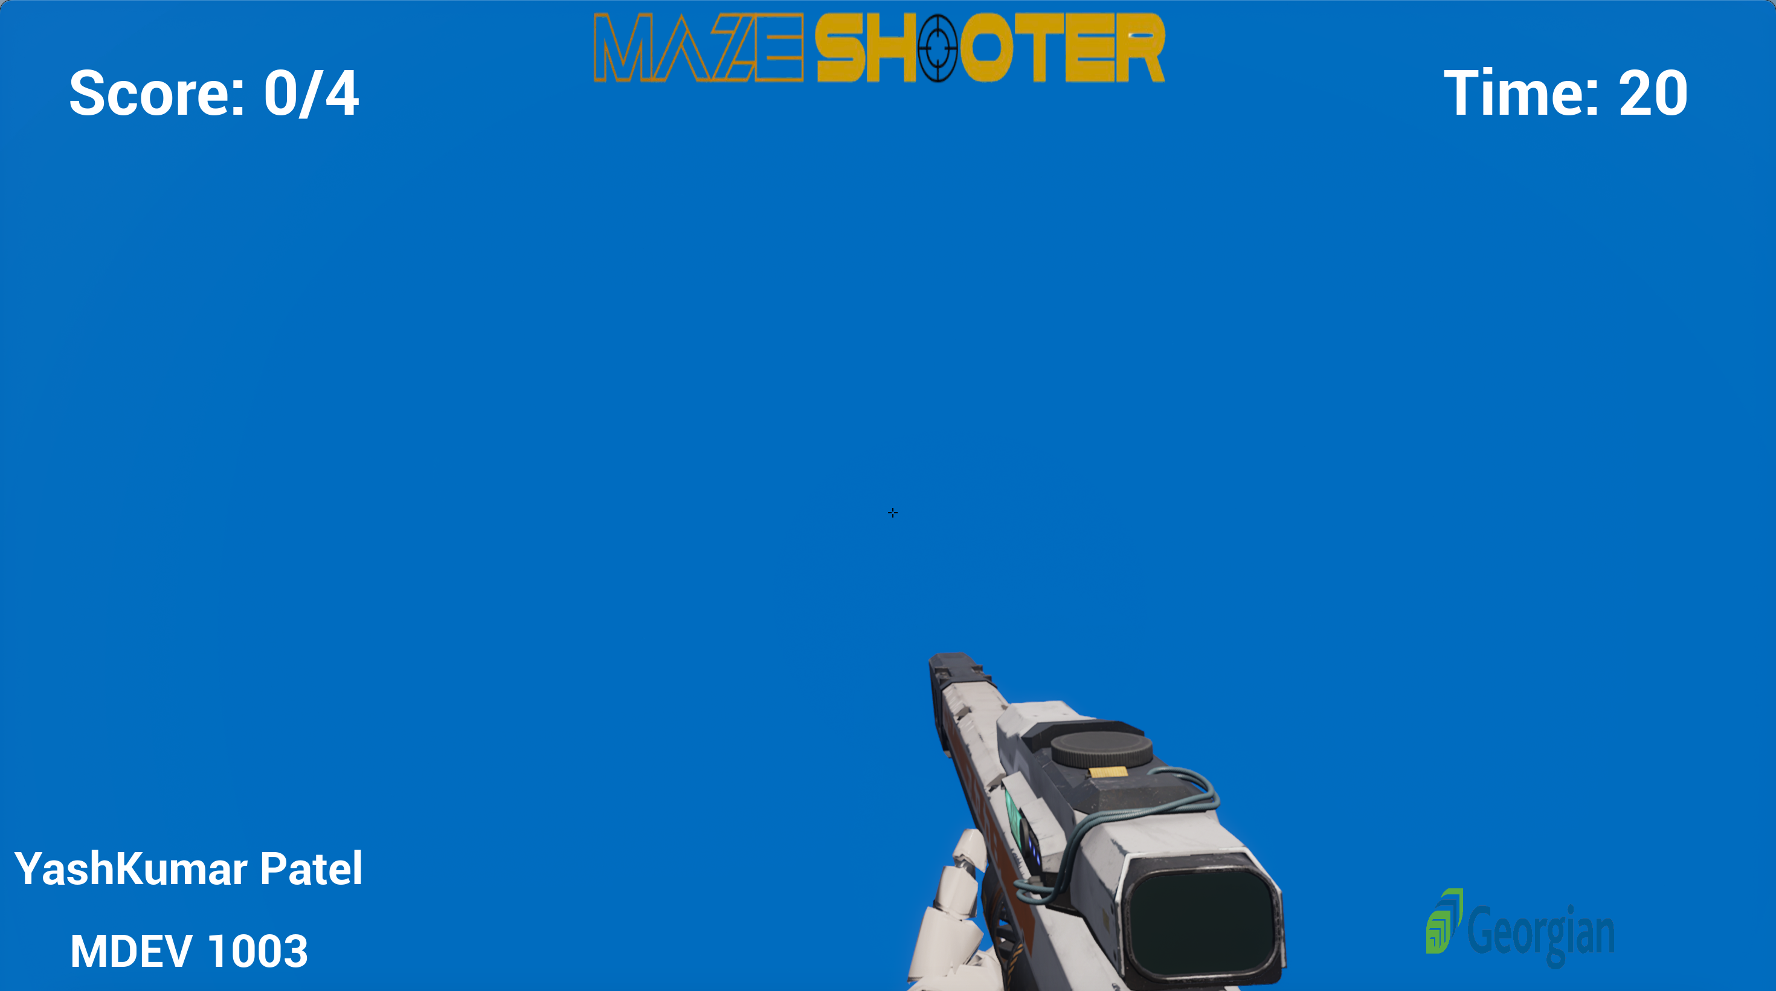

OBJECTIVE
Solve the Maze
Find targets to shoot them
Shoot all targets and reach the last target within time to win the game

Slide 8
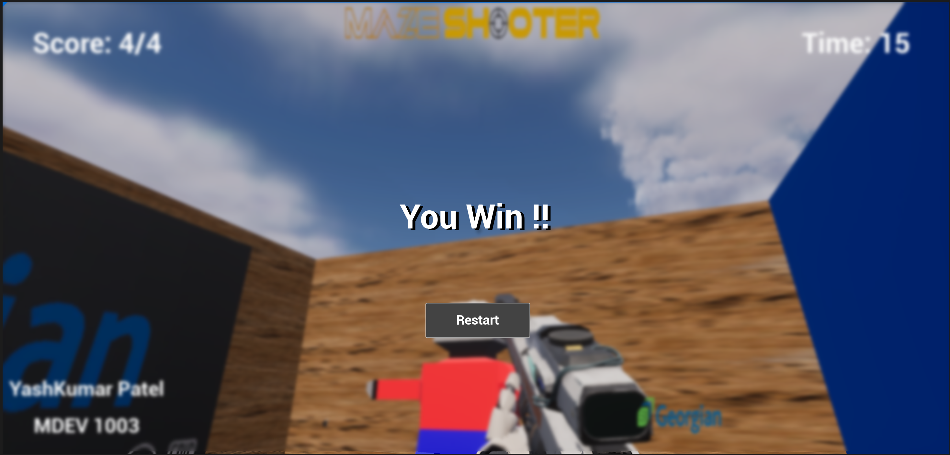
Victory Mode

Slide 9
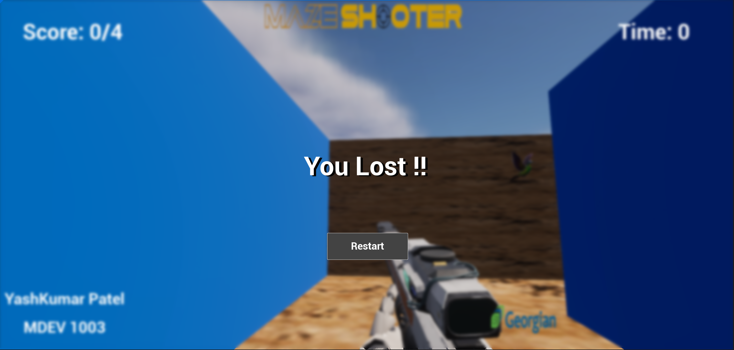
Lost Mode

Slide 10
END
YASHKUMAR PATEL
MDEV1003 Mobile Game Design
Student Number: 200583719

